Slide 1
Invoke functions
Invoke functions

Slide 2
Invoke functions
Use the following data set and enter it directly.
SalesID | Customer Name | Total Sales
1 | John Doe | 1000
2 | Jane Smith | 2000
3 | Bob Johnson | 1500

Slide 3
Invoke functions
In Power Query, go to In Home → New Source → Empty Query .
Rename the query in CalculateTax ( in the right panel ) .
Open the Editor advanced ( Home → Editor advance ).
Replace the code with:
Total as number) as number =>
let
TaxRate = 0.15,
TaxAmount = Total * TaxRate
in
TaxAmount

Slide 4
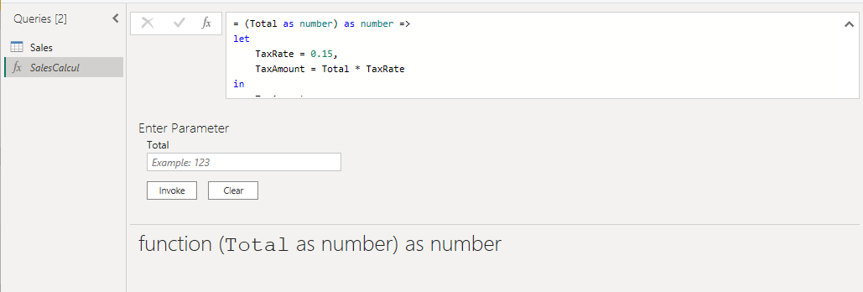
Invoke functions
Click OK .
This function takes a Total Sales value and applies a 15% tax .

Slide 5
Invoke functions
Select the table containing SalesID , Customer Name, Total Sales .
Click Add a column → Column personalized .
In the Add dialog box a column personalized :
Give it a name, for example Sales Tax .
Use the function CalculateTax and pass the column Total Sales as an argument:
= CalculateTax ([Total Sales])
6. Add a new column personalized .
7. Use this formula to add tax to the initial total:
= [Total Sales] + [Sales Tax]
8. Click OK .

Slide 6
Invoke functions
The expected result
SalesID | Customer Name | Total Sales | Sales Tax | Total with Tax
1 | John Doe | 1000 | 150 | 1150
2 | Jane Smith | 2000 | 300 | 2300
3 | Bob Johnson | 1500 | 225 | 1725

Slide 7
THANKS
THANKS

